Slide 1

Introduction to Statistics

Slide 2
Introduction to Statistics
Describing and Summarizing Data: Central Measure, Spread, Skew
Detecting and correcting Outliers
Finding Statistical relationship between two sets of data
Inferential statistics - sample vs population
Estimation Technique
Hypothesis Testing
Confidence Intervals
Case Study: Exit poll analysis

Slide 3

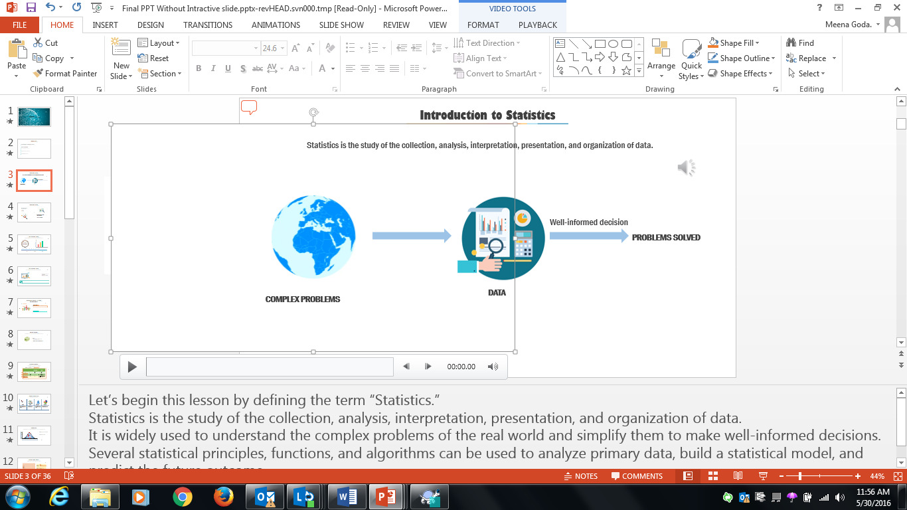
Introduction to Statistics
Statistics is the study of the collection, analysis, interpretation, presentation, and organization of data.
Well-informed decision
PROBLEMS SOLVED
COMPLEX PROBLEMS
DATA
Notes:
Let’s begin this lesson by defining the term “Statistics.”
Statistics is the study of the collection, analysis, interpretation, presentation, and organization of data.
It is widely used to understand the complex problems of the real world and simplify them to make well-informed decisions.
Several statistical principles, functions, and algorithms can be used to analyze primary data, build a statistical model, and predict the future outcome.

Slide 4

Statistics
Statistics is an area of applied mathematics concerned with data collection, analysis, interpretation, and presentation.
Your company has created a new drug that may cure cancer. How would you conduct a test to confirm the drug’s effectiveness?
The latest sales data have just come in, and your boss wants you to prepare a report for management on places where the company could improve its business. What should you look for? What should you not look for?

Slide 5
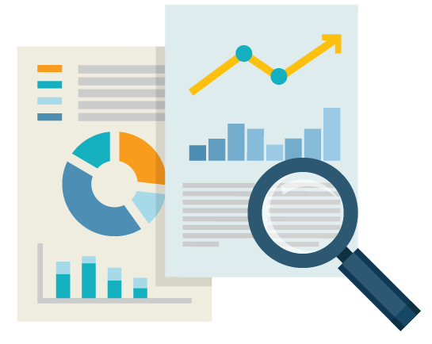
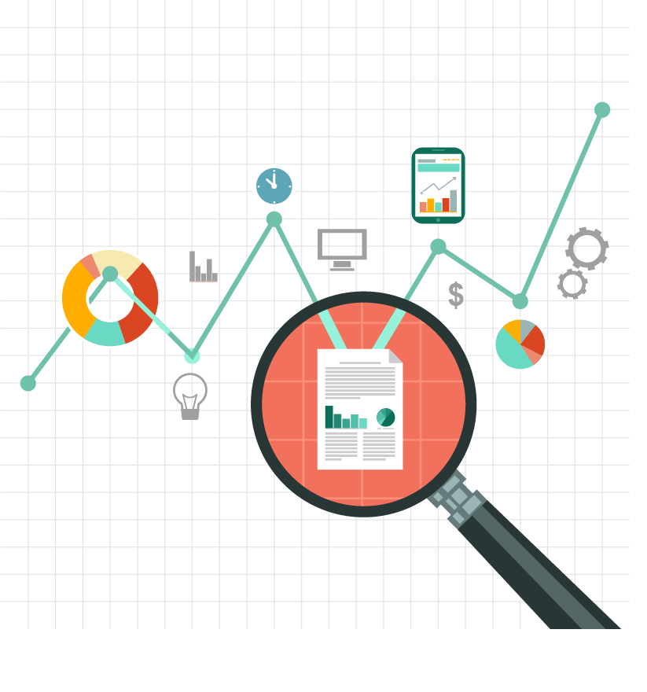
Introduction to Statistics
Techniques available to analyze data:
Statistical principles
Functions
Algorithms
What you can do using statistical tools:
Analyze the primary data
Build a statistical model
Predict the future outcome
Analyze the primary data,
build a statistical model, and
predict the future outcome.
Notes:
Several statistical principles, functions, and algorithms that can be used to analyze the primary data, build a statistical model, and predict the future outcome.

Slide 6
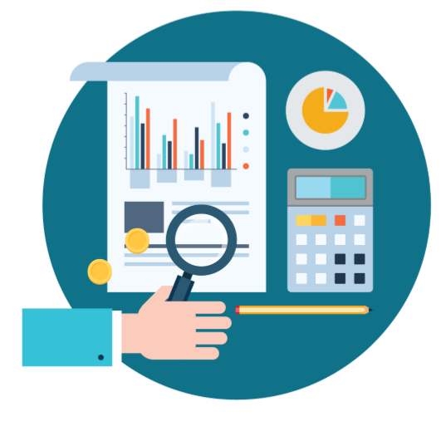


Statistical vs. Non-Statistical Analysis
Statistical Analysis
Non-statistical Analysis
Statistical Analysis is:
scientific
based on numbers or statistical values
useful in providing complete insight of the data
Non-statistical Analysis is:
based on generic information
exclusive of statistical or quantitative analysis
Although both forms of analysis provide results, quantitative analysis provides more insight and a clearer picture. This is why statistical analysis is important for businesses.
Notes:
An analysis of any situation can be done in two ways: Statistical analysis or a non-statistical analysis.
Click each image to learn more about statistical analysis and non-statistical analysis.
Statistical analysis is scientific, based on numbers or statistical values and provides complete insight to the data.
Non-statistical analysis is generic information and does not include any statistical or quantitative analysis.
Although both forms of analysis provide results, quantitative analysis provides more insight and a clear picture. This is why statistical analysis is important for businesses.

Slide 7
Major Categories of Statistics
There are two major categories of statistics: Descriptive analytics and inferential analytics
Descriptive analytics organizes the data and focuses on the main characteristics of the data.
HIGH
MEDIUM
MATH SCORES
LOW
1 8 4 7 3 6 9 2 5 0
NUMBER OF STUDENT
0 1 2 3 4 5 6 7 8 9
LOW
MEDIUM
HIGH
Notes:
There are two major categories of statistics: Descriptive analytics and inferential analytics.
Descriptive Analytics helps organize the data and focuses on the main characteristics of the data. It provides a concise summary of the data. You can summarize data numerically or graphically. For example, you can collect all the data about the visitors to your website for a week and summarize the data.
Inferential Analytics generalizes the larger dataset and applies the probability theory to draw a conclusion. In this approach, a random sample of data is taken from a population to describe and make inferences about the population. Inferential statistics is valuable when it is not convenient or possible to examine each member of an entire population.
Let’s understand both categories better through an example.

Slide 8
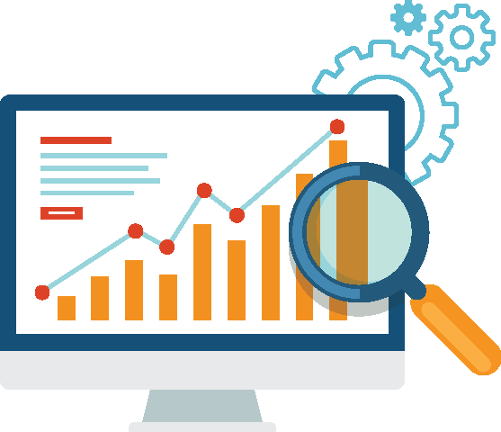
Major Categories of Statistics
Random sample is drawn from the population
Used to describe and make inferences about the population
Inferential analytics is valuable when it is not possible to examine each member of the population.

Slide 9

Major Categories of Statistics: Example
Study of height in the population
Tall
Inferential Method
Medium
Categorize height as Tall, Medium, and Short
Take a sample to study from the population.
Short
Descriptive Method
Record the height of each and every person.
Provide the tallest, shortest, and average height of the population.
Notes:
Suppose you want to study the height of persons in an entire population; you can do this in two ways:
Were you to record the height of each person in the population, it would be a tedious process. Instead, if you categorize height as “tall,” “medium,” and “small” and then take only a sample from the population, this is an “inferential” analysis.
In the descriptive analysis method, you would record the height of every person in the population and then provide data for the maximum height, minimum height, and average height of the population.

Slide 10

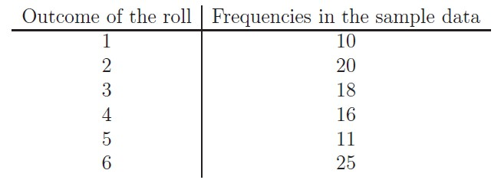
Example : Descriptive and Inferential Statistics
Consider event of tossing dice. The dice is rolled 100 times and the results are forming the sample data. Descriptive statistics is used to grouping the sample data to the following table
Inferential statistics can now be used to verify whether the dice is a fair or not.
Descriptive and inferential statistics are interrelated. It is almost always necessary to use methods of descriptive statistics to organize and summarize the information obtained from a sample before methods of inferential statistics can be used to make more thorough analysis of the subject under investigation.

Slide 11



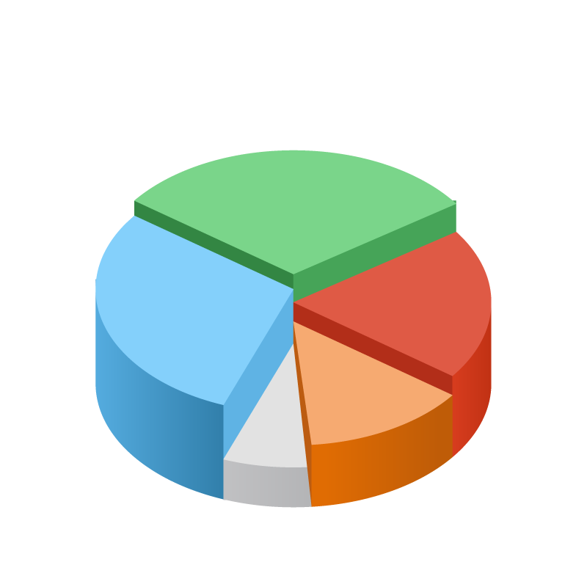
Statistical Analysis Considerations
Purpose
Clear and well-defined
Document Questions
Prepare a questionnaire in advance
Define Population of Interest
Select population based on the purpose of analysis
Determine Sample
Based on the purpose of study
Notes:
Before beginning a statistical analysis, you need to keep in mind certain considerations to make your study meaningful and systematic. Click each image to learn more.
Click image 1:
The first consideration is “purpose.” The purpose of the statistical analysis should be clear.
Click image 2:
The second consideration is to document the questions. Prepare the questions that you will ask the population of the study in advance.
Click image 3:
The third consideration is to define the population of interest: Select the population for your study based on the purpose of your analysis.
Click image 4:
Determine the sample that you want to draw from the population based on the purpose of your study.

Slide 12
Population and Sample
A population consists of various samples. The samples together represent the population.
A sample is:
The part/piece drawn from the population
The subset of the population
A random selection to represent the characteristics of the population
The representative analysis of the entire population
Population
Case Study- Consider a scenario wherein you’re asked to perform a survey about the eating habits of teenagers in the US
Notes:
Let’s understand population and sample through the visual.
Population consists of various samples. A sample is the part/piece drawn from the large population for statistical analysis. It can also be treated as a subset of the population. A sample should be random to help ensure that it has all the characteristics of the population and is also representative of the population.

Slide 13
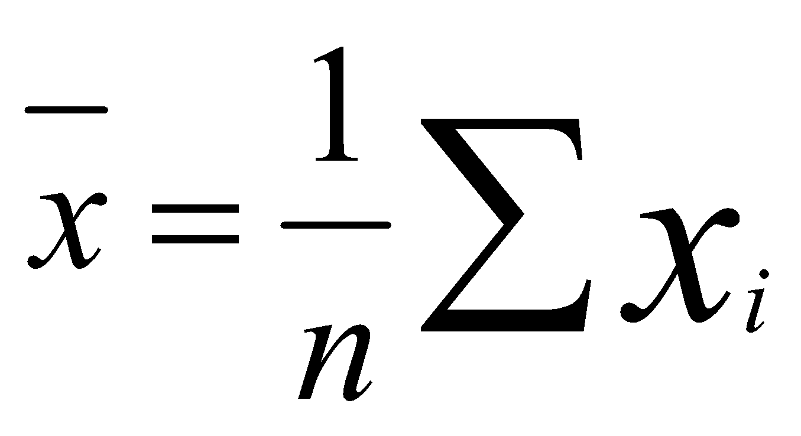
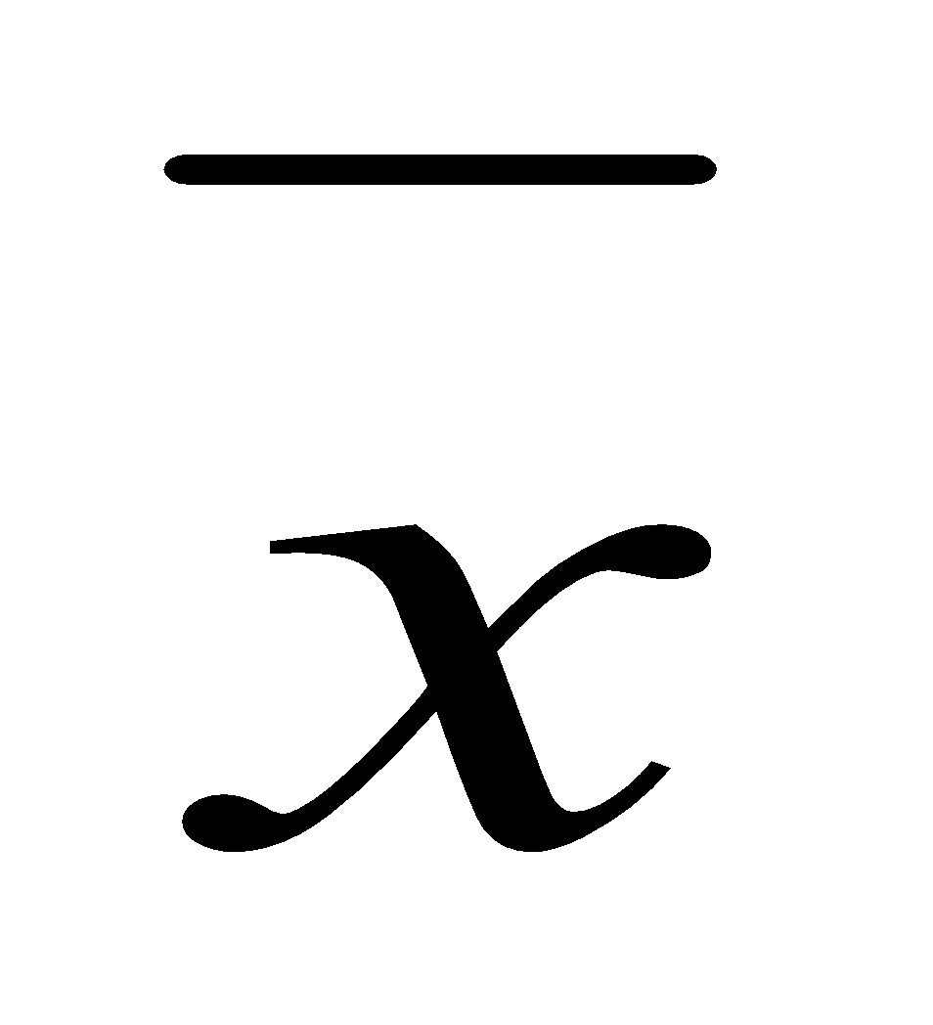
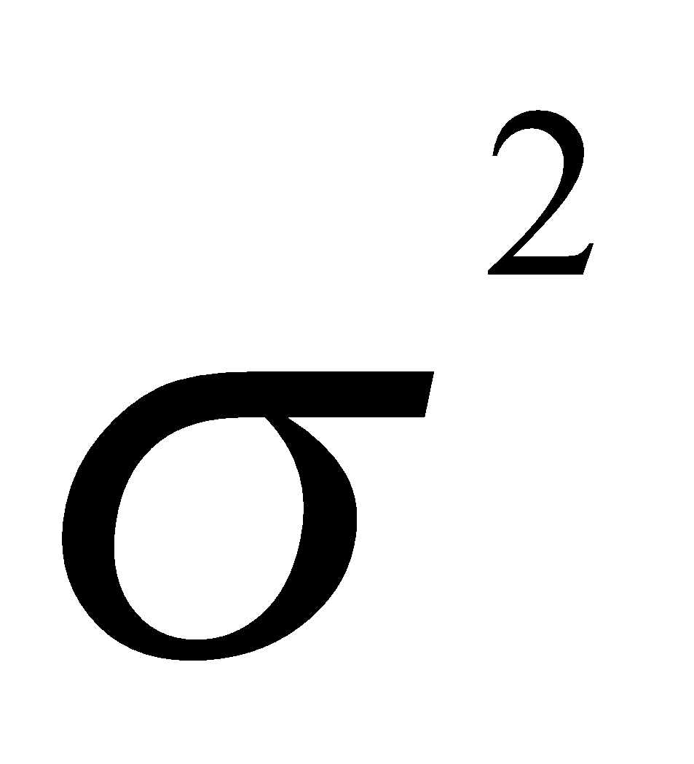
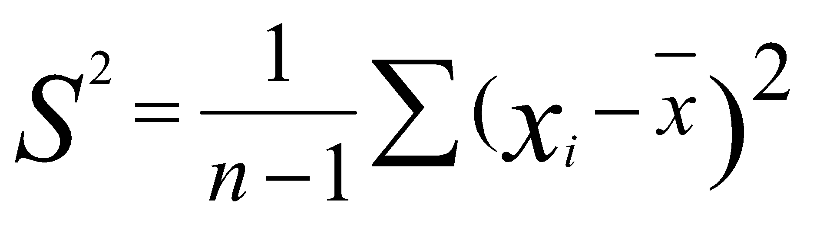
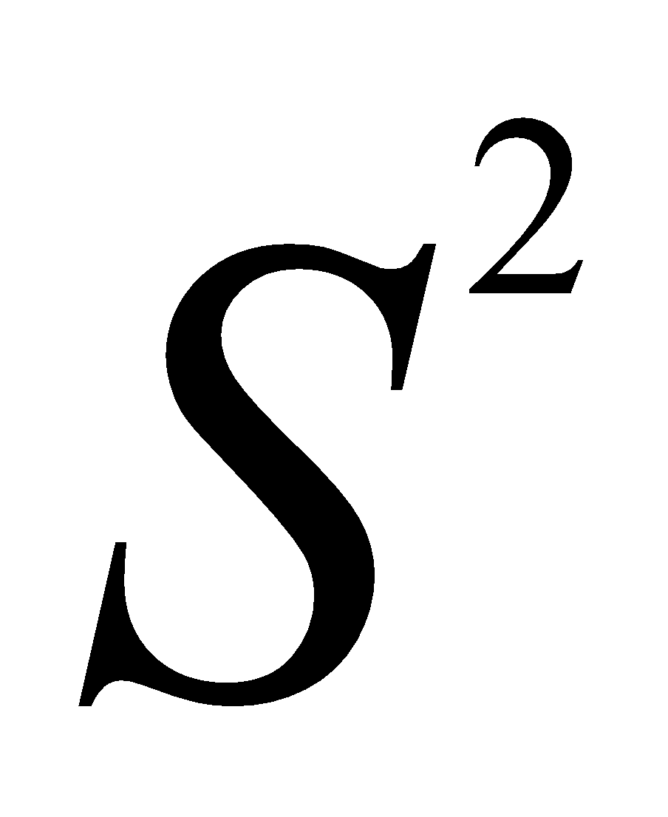

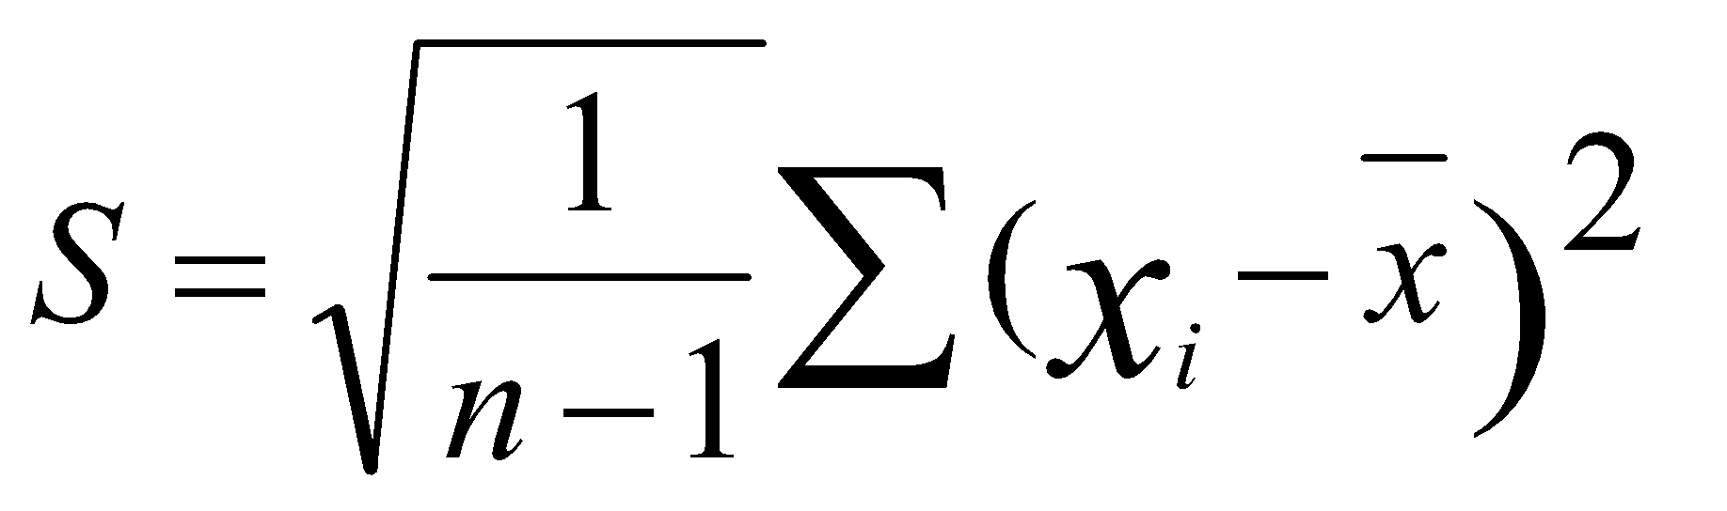

Statistics and Parameters
Statistics are quantitative values calculated from the sample.
Parameters are the characteristics of the population.
Sample 🡪 X_{o}, X₁,X₂……….X_{n}
 | Population Parameters | Sample Statistics | Formula
Mean | µ
Variance
Standard Deviation
Notes:
Let’s understand the terms “statistics” and “parameters” which we’ll be using throughout this lesson.
“Statistics” are quantitative values calculated from the sample.
“Parameters” are the characteristics of the population.
Suppose you have Xo, X1,X2……….Xn, a sample from a population, and you want to know some vital information such as average, most occurring characteristic, and so on. These are calculated using formulas displayed on the screen.
Mean is the average, a typical value present in the distribution, and is calculated by summing the values and dividing them by the number of values.
Variance measures the sample variability.
Standard deviation explains how spread out the data is from the mean. The greater the standard deviation, the greater the spread in the data. It is measured in the same units as the mean.

Slide 14
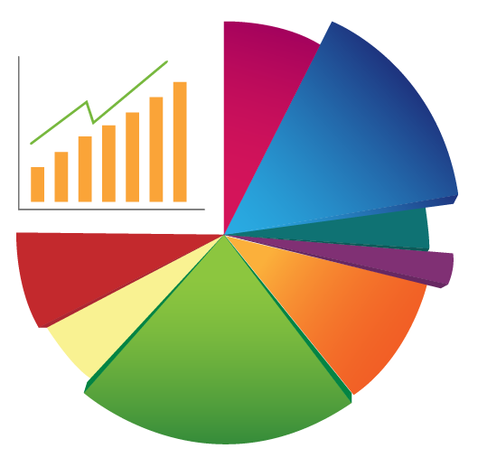
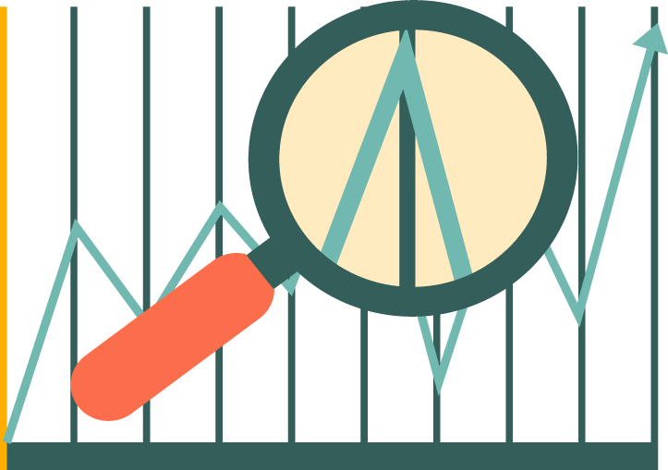
Terms Used to Describe Data
SEARCH
INSPECT
CHARACTERIZE
CONCLUSION
Search is used to find unusual data. Data that does not match the parameters.
Inspect refers to studying the shape and spread of data.
Characterize refers to determining the central tendency of the data.
Conclusion refers to preliminary or high-level conclusions about the data.
Notes:
Certain terms are used in statistical analysis to understand the data and gain insight into it. Some of these terms are as follows:
Search: Search is typically used to find unusual data. Unusual data refers to those data that doesn’t meet the parameters set at the beginning.
Inspect: Inspect refers to studying the shape of the dataset and determining how spread out it is.
Characterize: Characterize determines the central tendency of the data.
Conclusion: Based on the understanding of “search,” “inspect,” and “characterize,” we can draw some preliminary or high- level conclusions about the data.

Slide 15
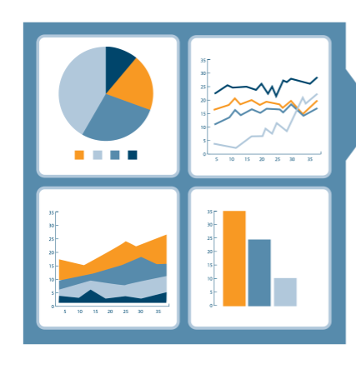
Statistical Analysis Process
There are four steps in the statistical analysis process.
Step 1: Find the population of interest that suits the purpose of statistical analysis.
Step 2: Draw a random sample that represents the population.
Step 3: Compute sample statistics to describe the spread and shape of the dataset.
Step 4: Make inferences using the sample and calculations. Apply it back to the population.
Notes:
Let’s take a look at the statistical analysis process.
Click each step to learn more about it.
The first step is to find the population of interest, which is closely tied to the purpose of statistical analysis. The second step is to draw a random sample which is representative of the population. The third step is to compute sample statistics to describe the sample in terms of spread and shape of the dataset. The final step is to make inferences using the sample and calculations, and apply them to the population.
We need to understand data distribution to carry out the statistical analysis effectively.

Slide 16
Inferential Statistics
Inferential statistics uses a random sample from the data to make inferences about the population.
Inferential statistics can be used only under the following conditions:
A complete list of the members of the population is available.
A random sample has been drawn from the population.
Using a pre-established formula, you determine that the sample size is large enough.
Inferential statistics can be used even if the data does not meet the criteria.
It can help determine the strength of the relationships within the sample.
If it is very difficult to obtain a population list and draw a random sample, do the best you can with what you have.
Notes:
We already know that inferential statistics uses a random sample from the data to make inferences about the population. This is a valuable method when each and every member of the population cannot be studied.
Inferential statistics can be used only under the following conditions:
You have a complete list of the members of the population.
You draw a random sample from this population.
Using a pre-established formula, you determine that your sample size is large enough.
Inferential statistics can be used even if your data does not meet these criteria.
Inferential statistics can help determine the strength of the relationships within your sample.
If it is very difficult to obtain a population list and/or draw a random sample, then you do the best you can with what you have.

Slide 17

Data Distribution

Slide 18
Data Distribution
The collection of data values arranged in a sequence according to their relative frequency and occurrences.
Range of the data refers to minimum and maximum values.
Frequency indicates the number of occurrences of a data value.
Central tendency indicates data accumulation toward the middle of the distribution or toward the end.
1.5
1
0
19.1%
19.1%
-0.5
-1
15.0%
15.0%
9.2%
9.2%
-1.5
4.4%
4.4%
1.7%
1.7%
-3
-2.5
-2
-1.5
-1
-0.5
0
0.5
1
1.5
2
2.5
3
Notes:
Data distribution is the collection of data values that are arranged in order along with their relative frequency or occurrences.
To understand any kind of problem, it is important to describe the data in terms of its spread and shape using graphical techniques.
Range of the data indicates the quantitative values, minimum and maximum.
Frequency of the data indicates the number of occurrences of any particular data value in the given dataset.
Central tendency indicates whether the data values accumulate in the middle of distribution or toward the end.

Slide 19
Measures of Central Tendency
The measures of central tendency are Mean, Median, and Mode.
Mean is the average.
Determine the mean score of these Math scores.
1. 80
2. 70
3. 75
4. 90
5. 80
6. 78
7. 55
8. 60
9. 80
Ʃ [80+70+75+90+80+78+55+60+80]/9
Mean = 74.22
Median is the 50th percentile.
55 60 70 75 78 80 80 80 90
Median = 78
Mode is the most frequent value.
55 60 70 75 78 80 80 80 90
Mode = 80
Notes:
Following are the measures of central tendency:
Mean: The sum of all the values in the dataset divided by the number of values
Median: The data value right in the middle of the dataset or the 50th percentile
Mode: The data value which is the most common or frequent

Slide 20
Percentiles in Data Distribution
A percentile (or a centile) indicates the value below which a given percentage of observations fall.
Observations
98
95
92
75th percentile =91
Third Quartile
90
85
81
50th percentile =80
Second Quartile or Median
79
70
63
25th percentile =59
First Quartile
55
47
42
Notes:
Let’s understand percentile in data distribution.
A percentile (or a centile) is a measure used in statistics indicating the value below which a given percentage of observations in a group of observations falls. For example, the 20th percentile is the value (or score) below which 20% of the observations may be found.
Usually, we report percentiles as below:
The 25th percentile is called the first quartile.
The 50th percentile is called the median or second quartile.
The 75th percentile is called the third quartile.

Slide 21
Dispersion
Dispersion denotes how stretched or squeezed a distribution is.
Observations
98
95
92
75th percentile = 91
Range: The difference between the maximum and minimum values.
Inter-Quartile Range: Difference between the 25th and 75th percentiles.
Variance: Data values around the Mean. (74.75)
Standard Deviation: Square root of the variance measured in small units.
90
85
81
50th percentile = 80
79
70
63
25th percentile = 59
55
47
42
Notes:
In statistics, dispersion (also called variability, scatter, or spread) denotes how stretched or squeezed a distribution is. Common examples of measures of statistical dispersion are the variance, standard deviation, and interquartile range.
Let’s take a look at some of the measures of dispersion.
Click each heading to learn more about it.
Range refers to the difference between the maximum and minimum data values.
Inter-quartile range refers to the difference between the 25th and 75th percentiles.
Variance refers to the data values around the mean value.
Standard deviation is the square root of the variance, measured in the same units. It also indicates how spread out the data is.

Slide 22



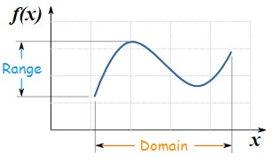
Measures of Spread & Shape
Range: It is the given measure of how spread apart the values in a data set are.
Range : The sample range of the variable is the difference between its maximum and minimum values in a data set: Range = Max −Min.
E.g.:
7 participants in bike race had the following finishing times in minutes: 28,22,26,29,21,23,24.
What is the range?
Ans :
22

Slide 23

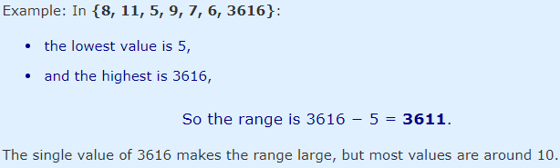
The Range Can Be Misleading
The range can sometimes be misleading when there are extremely high or low values.
Note : Such out of range values are called outliers
Solution : use Interquartile Range or Standard Deviation
23

Slide 24
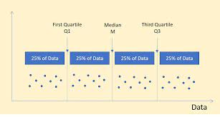
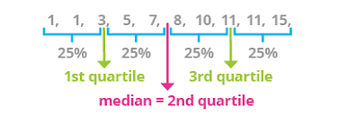
Quartiles
In statistics, Quartiles are the set of values which has three points dividing the data set into four identical parts. We ordinarily deal with a large amount of numerical data, in stats. There are several concepts and formulas, which are extensively applicable in various researches and surveys.

Slide 25
Quartiles
A quartile divides data into three points— a lower quartile, median, and upper quartile—to form four groups of the dataset.
The lower quartile, or first quartile, is denoted as Q1 and is the middle number that falls between the smallest value of the dataset and the median.
The second quartile, Q2, is also the median.
The upper or third quartile, denoted as Q3, is the central point that lies between the median and the highest number of the distribution.
First quartile: the lowest 25% of numbers
Second quartile: between 25.1% and 50% (up to the median)
Third quartile: 50.1% to 75% (above the median)
Fourth quartile: the highest 25% of numbers
hen the quartiles are given by;
Q₁ = [(n+1)/4]th item
Q₂ = [(n+1)/2]th item
Q₃ = [3(n+1)/4]th item

Slide 26

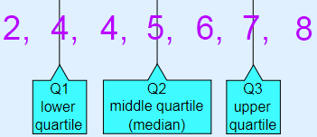




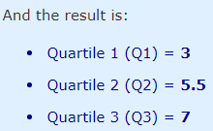
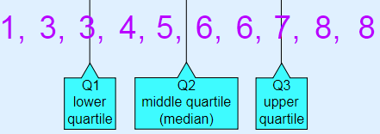
Quartiles
And the result is:
Quartile 1 (Q1) = 4 , Quartile 2 (Q2), which is also the Median, = 5, Quartile 3 (Q3) = 7
26

Slide 27

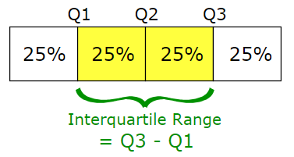
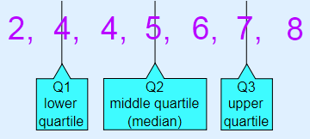


Interquartile Range
The "Interquartile Range" is from Q1 to Q3:
Interquartile Range
The interquartile range (IQR) is the difference between the upper and lower quartile of a given data set and is also called a midspread. It is a measure of statistical distribution, which is equal to the difference between the upper and lower quartiles

Slide 28
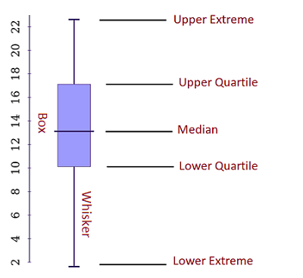

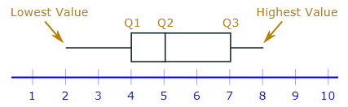
Box and Whisker Plot
We can show all the important values in a "Box and Whisker Plot", like this:
A box and whisker plot (also known as a box plot) is a graph that represents visually data from a five-number summary. These numbers are median, upper and lower quartile, minimum and maximum data value (extremes).
Lower Extreme – the smallest value in a given dataset.
Upper Extreme – the highest value in a given dataset.
Median value – the middle number in the set.
Lower Quartile – below that value, the lower 25% of the data are contained.
Upper Quartile – above that value, the upper 25% of the data are contained.
“Whiskers” – the lines that extend from the boxes. They are used to indicate variability out of the upper and lower quartiles.
28

Slide 29
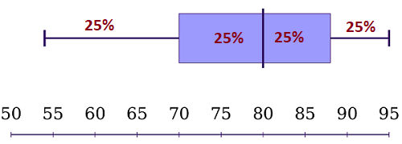

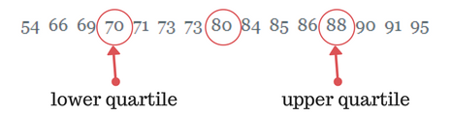
Example 1: a simple box and whisker plot
Suppose you have the math test results for a class of 15 students. Here are the results:
91 95 54 69 80 85 88 73 71 70 66 90 86 84 73
Step 1: Order the data points from least to greatest.
54 66 69 70 71 73 73 80 84 85 86 88 90 91 95
Step 2: Find the median of the data:
Step 3: Find the middle points of the two halves divided by the median (find the upper and lower quartiles).
Step 4: Find the extreme values.
Extreme values = 54 and 95.

Slide 30
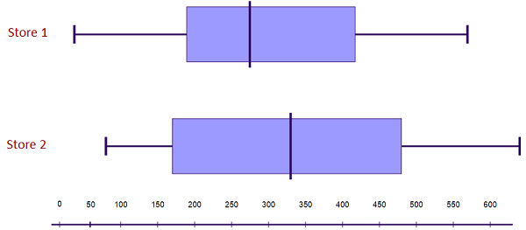
interpreting the box and whisker plot results:
The box and whisker plot shows that 50% of the students have scores between 70 and 88 points.
In addition, 75% scored lower than 88 points, and 50% have test results above 80. So, if you have test results somewhere in the lower whisker, you may need to study more.
Interpreting the results:
Store 2’s highest and lowest sales are both higher than Store 1’s relevant sales.
In addition, Store 2’s median sales value is higher than Store 1’s. Also, Store 2’s interquartile range is larger.
These results tell us that Store 2 consistently sells more computers than Store 1.

Slide 31
What is an outlier?
An outlier is a piece of data that is an abnormal distance from other points. In other words, it’s data that lies outside the other values in the set.
In this set of random numbers, 1 and 201 are outliers: 1, 99, 100, 101, 103, 109, 110, 201 “1” is an extremely low value and “201” is an extremely high value.
Of course, trying to find outliers isn’t always that simple. Your data set may look like this: 61, 10, 32, 19, 22, 29, 36, 14, 49, 3.

Slide 32
Calculate Outlier
How to Find Outliers Using the Interquartile Range(IQR)
An outlier is defined as being any point of data that lies over 1.5 IQRs below the first quartile (Q₁) or above the third quartile (Q₃)in a data set. High = (Q₃) + 1.5 IQR Low = (Q₁) – 1.5 IQR
Example Question: Find the outliers for the following data set: 3, 10, 14, 22, 19, 29, 70, 49, 36, 32.
Step 1: Find the IQR, Q₁(25th percentile) and Q₃(75th percentile). IQR = 22 Q₁ = 14 Q₃ = 36
Step 2: Multiply the IQR you found in Step 1 by 1.5: IQR * 1.5 = 22 * 1.5 = 33.
Step 3: Add the amount you found in Step 2 to Q₃ from Step 1: 33 + 36 = 69.

Slide 33
Calculate Outlier
Step 3: Subtract the amount you found in Step 2 from Q₁ from Step 1: 14 – 33 = -19. This is your lower limit. Set this number aside for a moment.
Step 5: Put the numbers from your data set in order: 3, 10, 14, 19, 22, 29, 32, 36, 49, 70
Step 6: Insert your low and high values into your data set, in order: -19, 3, 10, 14, 19, 22, 29, 32, 36, 49, 69, 70
Step 6: Highlight any number below or above the numbers you inserted in Step 6: -19, 3, 10, 14, 19, 22, 29, 32, 36, 49, 69, 70

Slide 34
Histogram
Graphical representation of data distribution
Features of a Histogram:
It was first introduced by Karl Pearson
To construct a Histogram, bin the range of values
Bins are consecutive, non-overlapping intervals of a
variable
Bins are of equal size
The bars represent the bins
The height of the bar represents the frequency of
the values in the bin
It helps assess the probability distribution of a variable
5.0
4.0
3.0
Frequency
2.0
1.0
0
20
30
40
50
60
70
80
90
100
Age
bin
Notes:
Histogram is a graphical representation of data distribution first introduced by Karl Pearson.
To construct a histogram, the first step is to "bin" the range of values—that is, divide the entire range of values into a series of intervals—and then count how many values fall into each interval. The bins are usually specified as consecutive, non-overlapping intervals of a variable. The bins must be adjacent and are usually of equal size.
In the graphical representation:
Each bar represents a group of values also called bin.
The height of the bar represents the frequency of the values in the bin.
Histograms help assess the probability distribution of a given variable by depicting the frequencies of observations occurring in a certain range of values.

Slide 35
Bell Curve: Normal Distribution
The bell curve is characterized by its bell shape and two parameters, mean and standard deviation.
Normal Curve
Bell curve is:
Symmetric around the mean
Symmetric on both sides of the center
Having equal mean, median, and mode values
Denser in the center compared to the tails or sides
Defined by mean and standard deviation
Known as the Gaussian curve
Standard Deviation
Mean
Dense
19.1%
19.1%
tails
15.0%
15.0%
tails
0.1%
0.5%
9.2%
9.2%
0.5%
0.1%
1.7%
4.4%
4.4%
1.7%
-3
-2.5
-2
-1.5
-1
-0.5
0
0.5
1
1.5
2
2.5
3
The Bell curve is fully characterized by the mean (μ) and standard deviation (σ).
Notes:
A normal distribution is the most commonly used distribution in statistics. It is characterized by its bell shape and its two parameters: mean and standard deviation.
A Bell curve or Normal Distribution:
It is symmetric around the mean.
If you draw line at the center, you’ll get the symmetric shapes on both sides.
The mean, median, and mode of a normal distribution are equal.
Normal distributions are denser in the center and less dense in the tails or sides.
Normal distributions are defined by two parameters, the mean (μ) and the standard deviation (σ).
The bell curve is also known as the “Gaussian curve.”
Let’s understand the bell curve better.

Slide 36
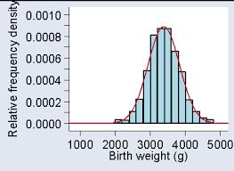
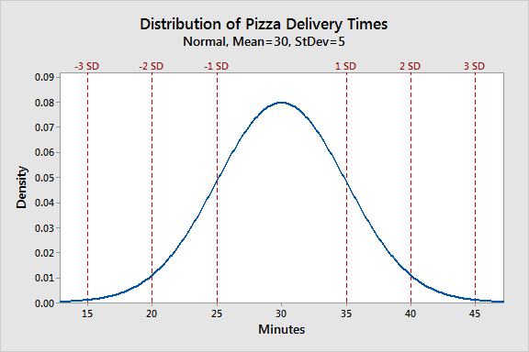
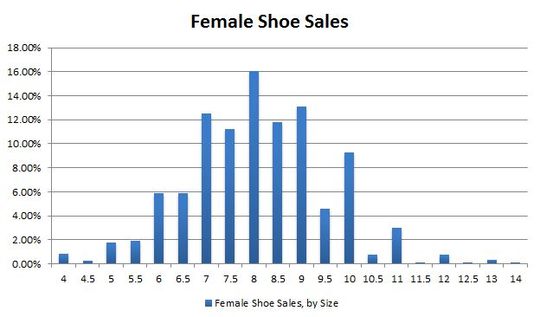

Slide 37
Bell Curve
The Bell curve is divided into three parts to understand data distribution better.
Peak
Peak = Within one standard deviation from the mean
Flanks
Flanks = Between one and two standard deviations from the mean
Tail
Tail = Beyond two standard deviations from the mean
Notes:
The bell curve is divided into three parts to understand the data distribution better.
Peak: It is where most of the observations occur. Generally, the peak is within one standard deviation from the mean.
Flanks: They are the areas beyond the peak but between one and two standard deviations from the mean.
Tails: They refer to the area far from the center of the distribution and considered to be beyond two standard deviations from the mean. Usually, five percent or less data falls under this.

Slide 38
Bell Curve: Left Skewed
Skewed data distribution indicates the tendency of the data distribution to be more spread out on one side.
Left Skewed
The data is left skewed
Mean < Median
The distribution is negatively skewed
Left tail contains large distributions
80
70
60
50
Frequency
40
30
20
10
0
1
2
3
4
5
6
7
8
9
10
11
12
13
Measurement
Notes:
Skewed data distribution indicates that the tendency of data distribution is to be more spread out on one side than the other.
In this graphical representation:
The data is left skewed.
Mean is less than Median.
The distribution is negatively skewed or represents negative statistics.
Left tail contains large distributions.

Slide 39

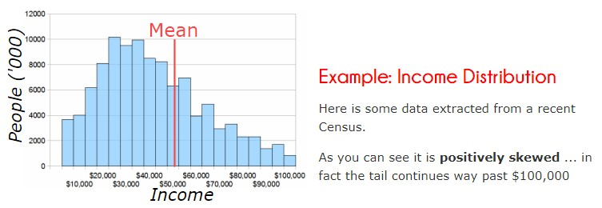
Bell Curve: Right Skewed
Right Skewed
The data is right skewed
The distribution is positively skewed
Mean > Median
Right tail contains large distributions
80
70
60
50
Frequency
40
30
20
10
0
1
2
3
4
5
6
7
8
9
10
11
12
13
Measurement
Notes:
In this graphical representation:
The data is right skewed or positively skewed distribution.
Mean is greater than Median.
Right tail contains large distributions.
Let’s now learn about Kurtosis, another popular measure of data distribution.

Slide 40
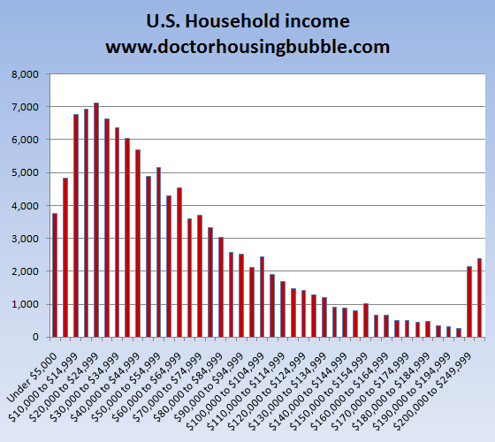
Apply skills learned till now , what do you read from this data ?

Slide 41
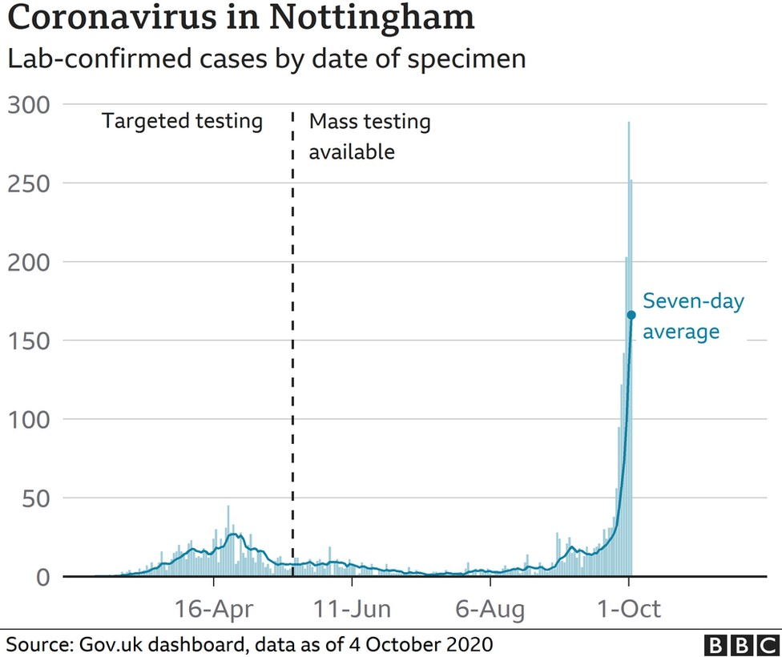
Apply skills learned till now , what do you read from this data ?

Slide 42
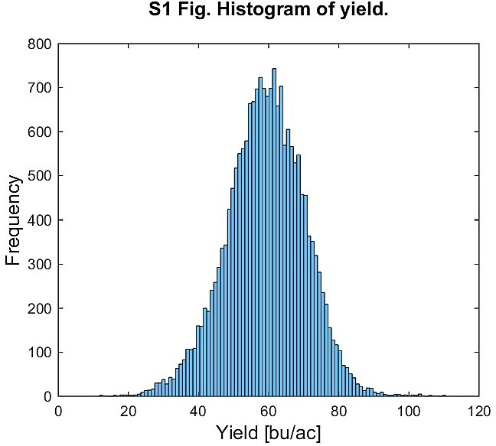
Apply skills learned till now , what do you read from this data ?
Crop yield is the term for the amount of harvested production per unit of land. In the U.S., crop yield for grain and oilseed crops is typically measured in bushels per acre.

Slide 43
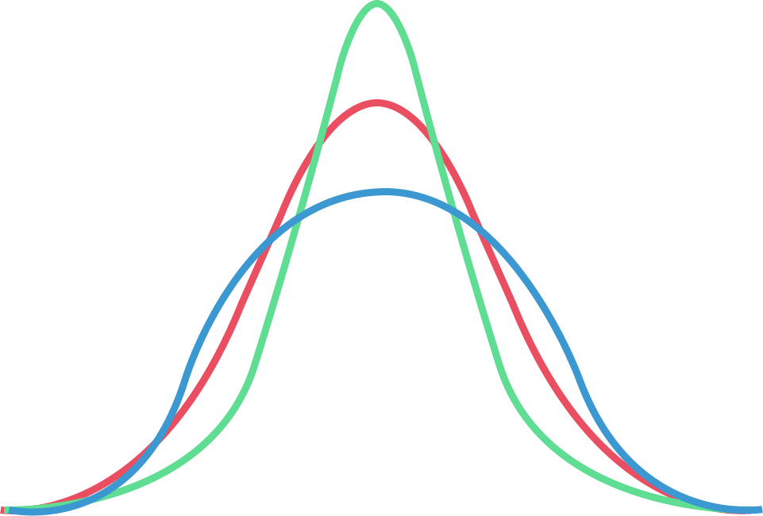
Kurtosis
Kurtosis describes the shape of a probability distribution.
a
Kurtosis measures the tendency of the data toward the center or toward the tail.
Platykurtic is negative kurtosis.
Mesokurtic represents a normal distribution curve.
Leptokurtic is positive kurtosis.
There are:
Different ways of quantifying a theoretical distribution.
Corresponding ways of estimating it from a sample of population.
(+) Leptokurtic
(0) Mesokurtic (Normal)
(-) Platykurtic
Notes:
In a similar way to the concept of skewness, kurtosis is a descriptor of the shape of a probability distribution and, just as there are for skewness, there are different ways of quantifying it for a theoretical distribution and corresponding ways of estimating it from a sample of a population.
Depending on the particular measure of kurtosis that is used, there are various interpretations of kurtosis.
Kurtosis measures the tendency of the data towards the center or toward the tail.
Platykurtic is negative statistics or negative kurtosis.
Mesokutic represents a normal distribution curve.
Leptokurtic is positive statistics or positive kurtosis.

Slide 44
Hypothesis

Slide 45

Conclusion or Prediction
This step involves reaching a conclusion and making predictions based on the data analysis.
Involves heavy use of mathematical and statistical functions
Requires model selection, training, and testing to help in forecasting
Is called machine learning as data analysis is fully or semi-automated with minimal or no human intervention
Notes:
In this step, the major task is to draw conclusions and make predictions. There is a heavy use of mathematical and statistical functions in this phase. Model selection, model training, and model testing are the important tasks from this phase that help in forecasting. This whole process is also known as machine learning where the data analysis becomes fully or semi-automated with minimal or no human intervention.

Slide 46
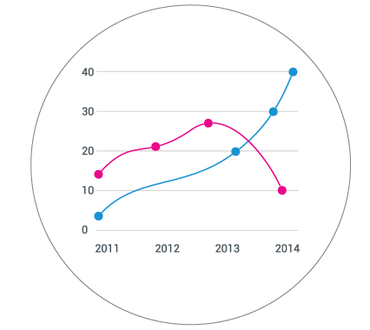
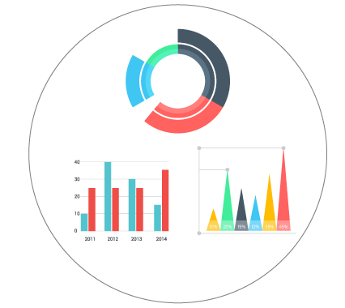
Meaning of Hypothesis
Hypothesis is used to establish the relationship between dependent and independent variables.
Hypothesis building begins in the data exploration stage, but becomes more mature in the conclusion or prediction phase.
Data Exploration Stage
Conclusion and Prediction
Key Considerations of Hypothesis Building
Testable explanations of a problem or observation
Used in quantitative and qualitative analyses to provide research solutions
Involves two variables, one dependent on another
Independent variable manipulated by the researcher
Dependent variable changes when the independent variable changes
Notes:
Hypothesis is used in research and analytics to understand the relationship between dependent and independent variables. Hypothesis building can begin in the data exploration stage, but it becomes more mature and perfect in the conclusion and predict phase.
Hypotheses are testable explanations of a problem or observation.
Formulating a hypothesis is used for both quantitative and qualitative analyses to address a research problem.
Hypotheses that suggest a causal relationship involve at least one independent and dependent variable; in other words, one variable which is presumed to affect the other. For example, Holiday season increases traffic and purchases on the website.
An independent variable is one whose value is manipulated by the researcher or data scientist.
A dependent variable is a variable whose values are presumed to change as a result of changes in the independent variable.
Let’s now look at hypothesis building using feature engineering.

Slide 47
Hypothesis Testing

Slide 48
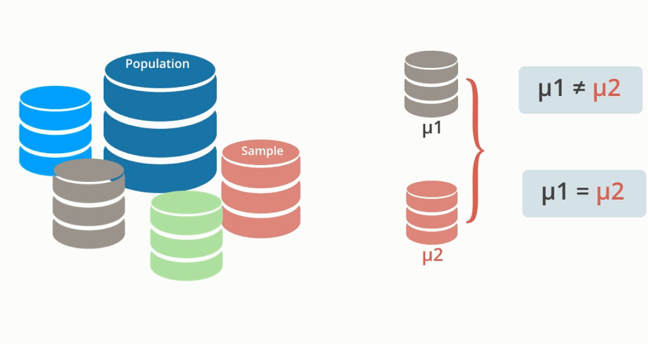
Hypothesis Testing
Alternative Hypothesis
Proposed model outcome is accurate and matches the data.
There is a difference between the means of S1 and S2.
Null Hypothesis
Opposite of the alternative hypothesis.
There is no difference between the means of S1 and S2.
Notes:
Two kinds of hypothesis can be made initially:
Alternative Hypothesis: This hypothesis indicates that the proposed model outcome is accurate and fits the data. There is a difference between sample data S1 and S2.
Null Hypothesis: This hypothesis is the logical opposite of the alternative hypothesis and does not support the proposed model. It suggests that there is no difference between sample data S1 and S2.

Slide 49
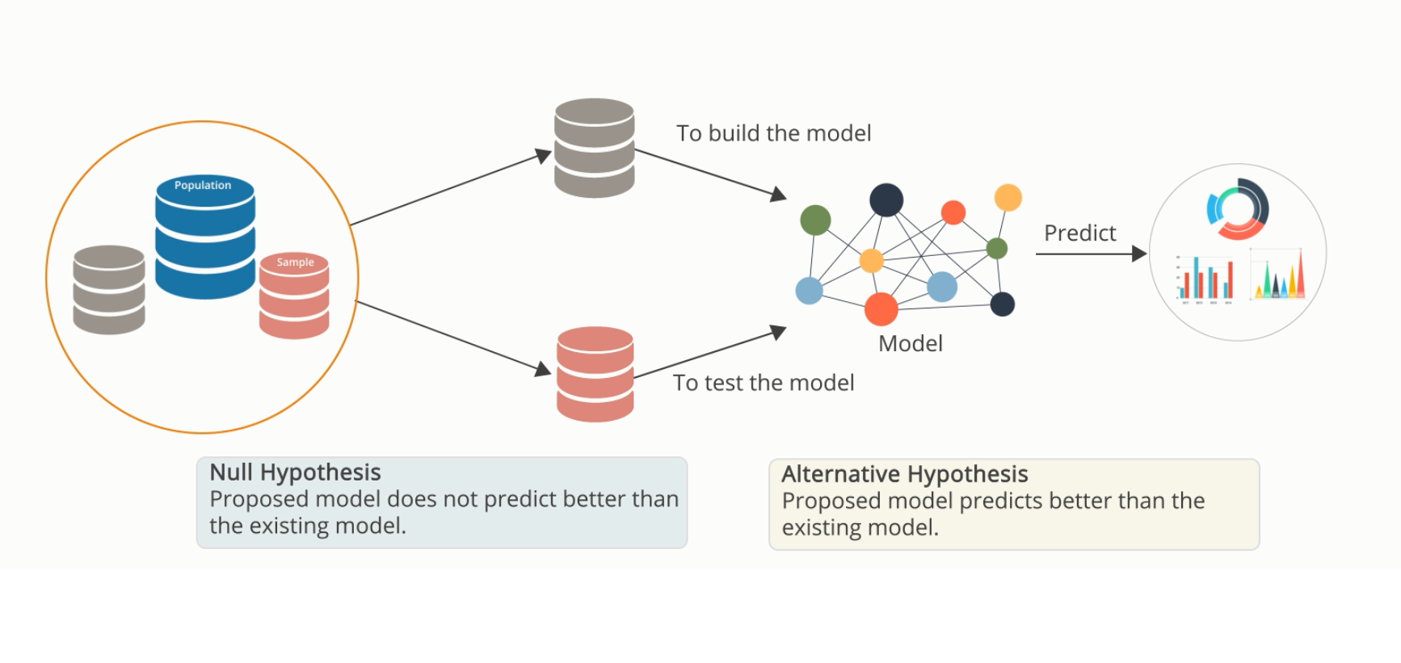
Hypothesis Testing Process
Choosing the training and test dataset, and evaluating them with the null and alternative hypothesis.
Usually the training dataset is between 60% to 80% of the big dataset and the test dataset is between 20% to 40% of the big dataset.
Notes:
The process of hypothesis testing begins by dividing a big dataset into training and test datasets, irrespective of the size of the dataset. This is one of the best techniques to design an accurate model.
Typically, the “training dataset” size is anywhere between sixty and eighty percent of the big dataset and the “test dataset” ranges between twenty and forty percent of the big dataset.
The Training dataset is used to build a new proposed model. It makes use of the available features and responses of the data sample.
The Test dataset is used to test the proposed model. The test dataset acts as new unseen data.
The Null hypothesis that was formulated will be proven right when the proposed model does not predict better than the existing model.
The Alternative hypothesis will be proven right if the proposed model predicts better than the existing model.

Slide 50

Hypothesis Testing
Hypothesis testing is an inferential statistical technique that determines if a certain condition is true for the population.
Alternative Hypothesis (H1) | Null Hypothesis (H0)
A statement that has to be concluded as true. | A statement of no effect or no difference.
It’s a research hypothesis. | It’s the logical opposite of the alternative hypothesis.
It needs significant evidence to support the initial hypothesis. | It indicates that the alternative hypothesis is incorrect.
If the alternative hypothesis garners strong evidence, reject the null hypothesis. | Weak evidence of alternative hypothesis indicates that the null hypothesis has to be accepted.
Notes:
Hypothesis testing is an inferential statistical technique to determine whether a certain condition is true for the entire population. For example, in a manufacturing company the hypothesis is that every dress manufactured has no defect. A study of each dress manufactured and noting the defects as they occur will prove or disprove the hypothesis that every dress is flawless.
A hypothesis test studies two opposing hypotheses about a population: the null hypothesis and the alternative hypothesis. The null hypothesis is the statement that has to be tested. Usually the null hypothesis is a statement of "no effect" or "no difference." The alternative hypothesis is the statement that has to be concluded as true.
To quickly summarize,
Alternative Hypothesis
It is a research hypothesis.
It needs a significant level of evidence to support the initial hypothesis or assumption.
If the alternative hypothesis garners strong evidence reject the null hypothesis.
Null Hypothesis
It is the logical opposite of alternative hypothesis.
It indicates that the alternative hypothesis is incorrect.
Weak evidence of alternative hypothesis indicates that the null hypothesis cannot be rejected.

Slide 51


Perform Hypothesis Testing
An example of clinical trials data analysis.
Company A
Company B
Null Hypothesis:
Both medicines are equally effective.
Alternative Hypothesis: Both medicines are NOT equally effective.
Notes:
This example shows how clinical trials data can be analyzed.
Suppose a pharmaceutical company wants to compare a medicine it manufactures with that of a competitor’s medicine, then hypothesis testing can be the method it adopts.
The null hypothesis would be that both the medicines are equally effective. The alternative hypothesis would be that the two medicines are NOT equally effective.

Slide 52
Hypothesis Testing: Process
There are four steps in the hypothesis testing process.
Step 4
Step 3
Make decision
p-value < α
p-value ≥ α
Step 2
Collect Data
Collect sample from population
Step 1
Set α Significant Level
Set α or choose the significant level for the population.
Set Hypothesis
H0 (μ₁ = μ₂): Equality
H1(μ₁ ≠ μ₂): Difference
Reject the null hypothesis if p-value < α
Fail to reject the null hypothesis if p-value ≥ α
Notes:
Let’s understand the process of hypothesis testing.
The first step is to set the hypothesis. The hypothesis could be “null” or “alternative.” The null hypothesis, or H₀, states that a population parameter is equal to a value. The alternative hypothesis, or H₁, states that the population parameter is different than the value of the population parameter in the null hypothesis. The alternative hypothesis is what is believed to be true or is to be proven true.
The next step is to set alpha or choose the significant level for the population.
The third step is to collect the sample from the population which represents the characteristics of the population.
The final step is to compare the p-value and alpha.
You reject the null hypothesis if p-value < α and fail to reject the null hypothesis if p-value ≥ α.

Slide 53
Data for Hypothesis Testing
There are three types of data on which you can perform hypothesis testing.
Continuous Data
Evaluate the mean, median, standard deviation, or variance.
Binomial Data
Evaluate the percentage and general classification of data.
Poisson Data
Evaluate rate of occurrence or frequency.
Notes:
There are three types of data on which you can perform hypothesis testing.
Continuous data: Evaluate the mean, median, standard deviation, or variance.
If you take the same example to test the efficacy of medicine; take the temperature of every person in the sample after three hours of administering the medicine. This would be referred to as continuous data.
Binomial data: Evaluate the percentage, general classification of data. When data is divided into two categories, you obtain binomial data. Supposing the sample population were asked if their fever had subsided and the answers could be Yes/No, then the percentage who said “Yes” should match the null hypothesis.
Poisson data: Evaluate rate of occurrence or frequency. If the sample is asked about how many times in a month they use the medicine and the rate of frequency is recorded and is then compared to the null hypothesis where the rate should be less than a certain number.

Slide 54
Estimation Technique
In statistics and analytics, estimation techniques are used to estimate population parameters based on sample data.
Point Estimation:
Sample Mean (x̄): The average of the sample data is often used as a point estimate of the population mean.
Sample Proportion (p̂): In the case of estimating a population proportion, the sample proportion is used as a point estimate.
Interval Estimation:
Confidence Intervals: Instead of providing a single point estimate, confidence intervals give a range of values within which the true population parameter is likely to fall. For example, a 95% confidence interval for the population mean gives a range of values that we are 95% confident contains the true mean.
Prediction Intervals: Similar to confidence intervals, prediction intervals provide a range within which a future observation is likely to fall.
Notes:
We already know that inferential statistics uses a random sample from the data to make inferences about the population. This is a valuable method when each and every member of the population cannot be studied.
Inferential statistics can be used only under the following conditions:
You have a complete list of the members of the population.
You draw a random sample from this population.
Using a pre-established formula, you determine that your sample size is large enough.
Inferential statistics can be used even if your data does not meet these criteria.
Inferential statistics can help determine the strength of the relationships within your sample.
If it is very difficult to obtain a population list and/or draw a random sample, then you do the best you can with what you have.

Slide 55
Estimation Technique
Maximum Likelihood Estimation (MLE):
MLE is a method for estimating the parameters of a statistical model. It seeks to find values for the parameters that maximize the likelihood function, which measures how well the model explains the observed data.
Method of Moments:
This technique estimates population parameters by equating sample moments (e.g., mean, variance) to their population counterparts. The method of moments aims to match the theoretical moments with the sample moments.
Bayesian Estimation:
In Bayesian statistics, estimation involves updating prior beliefs with observed data to obtain posterior distributions. Bayesian estimation provides a distribution of possible parameter values rather than a point estimate.
Notes:
We already know that inferential statistics uses a random sample from the data to make inferences about the population. This is a valuable method when each and every member of the population cannot be studied.
Inferential statistics can be used only under the following conditions:
You have a complete list of the members of the population.
You draw a random sample from this population.
Using a pre-established formula, you determine that your sample size is large enough.
Inferential statistics can be used even if your data does not meet these criteria.
Inferential statistics can help determine the strength of the relationships within your sample.
If it is very difficult to obtain a population list and/or draw a random sample, then you do the best you can with what you have.

Slide 56
Estimation Technique
Bootstrap Method:
The bootstrap is a resampling technique where multiple samples are drawn with replacement from the original data. This method can be used to estimate the sampling distribution of a statistic, allowing for the construction of confidence intervals.
Cross-Validation:
Commonly used in machine learning, cross-validation is a technique for estimating the performance of a predictive model by partitioning the data into subsets for training and testing.
Notes:
We already know that inferential statistics uses a random sample from the data to make inferences about the population. This is a valuable method when each and every member of the population cannot be studied.
Inferential statistics can be used only under the following conditions:
You have a complete list of the members of the population.
You draw a random sample from this population.
Using a pre-established formula, you determine that your sample size is large enough.
Inferential statistics can be used even if your data does not meet these criteria.
Inferential statistics can help determine the strength of the relationships within your sample.
If it is very difficult to obtain a population list and/or draw a random sample, then you do the best you can with what you have.

Slide 57
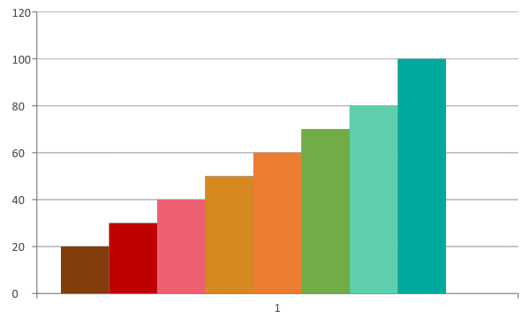
Applications of Inferential Statistics
Inferential Statistics has its uses in almost every field, such as business, medicine, data science, and so on.
Inferential Statistics
Is an effective tool for forecasting
Is used to predict future patterns
Notes:
Inferential Statistics is an effective forecasting tool widely used in businesses. For example, companies use it to predict their finances for future quarters. Using current data, future patterns can be inferred.

